Slide 1
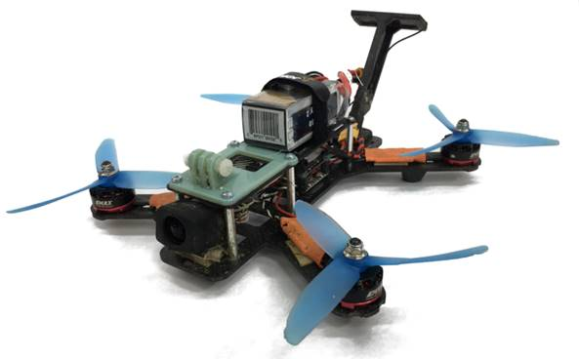
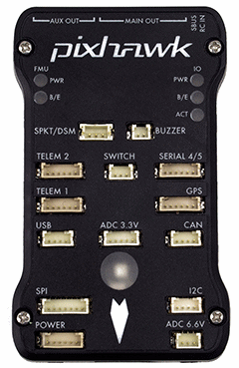
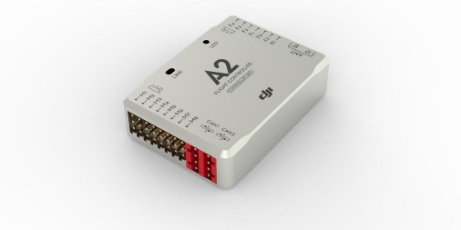
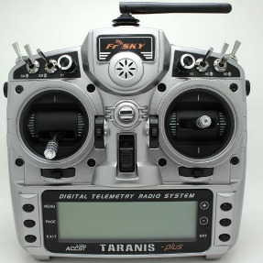
Simulator
Vehicle Model
Physics Engine
Actuator Signals
Flight Controller Firmware
Environment Model
Sensor Models
Rendering Engine
Simulated Sensor data
Data Collection
Companion Computer
(Path Planning, Mission Planning, SLAM etc.)

Slide 2

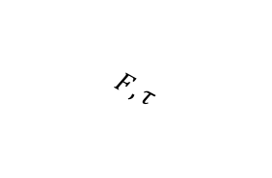
Simulator
Vehicle Model
Environment Model
Actuator signals
Flight Controller Firmware
$$F, τ$$
$$F, τ, g, ρ, P, T$$
Sensor Data
Sensor Models
Kinematics
Physics Engine
Desired state
Estimated state
Sensor Data
Pose
Desired state
API Layer
Rendering Engine
Perception
Data
Companion Computer
(Path Planning, Mission Planning, SLAM etc.)
Desired state
Estimated state, Sensor and
Perception Data

Slide 3












$$F_{1}$$
$$F_{2}$$
$$τ_{1}$$
$$τ_{2}$$
$$u_{1}$$
$$u_{2}$$
$$F_{3}$$
$$τ_{4}$$
$$τ_{3}$$
$$F_{4}$$
$$u_{4}$$
$$u_{3}$$

